Slide 1



Phase 2 Development Phase Airbnb Database
DLBDSPBDM01 – Build a Data Mart in SQL
Tutor: Musharaf Doger
Name: Anita Skynar
Matriculation: 92124577
Submission Date: 12 September 2024

Slide 2


Table of Contents
Introduction
Entity Relationship Model (ERM)
Table Creation
CREATE TABLE statement
INSERT INTO statement
Query Result
Test Cases
Integrity Check
JOIN statements
Setting up MySQL Workbench

Slide 3

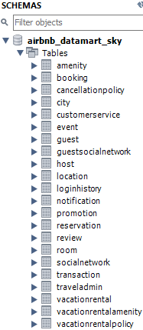
Introduction
Overview of the Airbnb Datamart Project:
In the development phase of the Airbnb Datamart project, the database schema from the updated conception phase was implemented within the MySQL Workbench.
This included creating the 22 tables and relationships as per the ERM Diagram and populating each table with at least 20 entries.

Slide 4
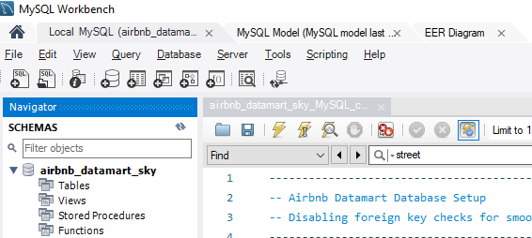

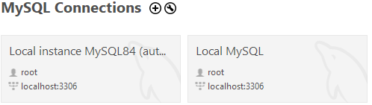
Setting Up MySQL Workbench
The database was developed using MySQL Workbench.
After downloading and installing MySQL (click here)…
Open MySQL Workbench.
Launch MySQL Workbench from your system or click here.
Set up a New Connection:
Click + under MySQL Connections.
In the "Setup New Connection" window:
Connection Name: Choose any name ( here: “airbnb_datamart_sky").
Hostname: Use localhost (or your server IP if applicable).
Port: Default is 3306.
Username: Use root or another MySQL username.
Password: Click "Store in Vault" and enter the MySQL password.
Connect to Database:
Click Test Connection to confirm it works.
Then click OK to save and open the connection.
Run the SQL Code:
Open your SQL file with all table creation, inserts, and test queries.
Copy and paste the SQL code into the SQL editor or use File > Open SQL Script to load the file.
Click the Execute button (lightning icon ) to run the code.
Verify Tables and Data:
Use SELECT * FROM queries to verify the data in each table.

Slide 5
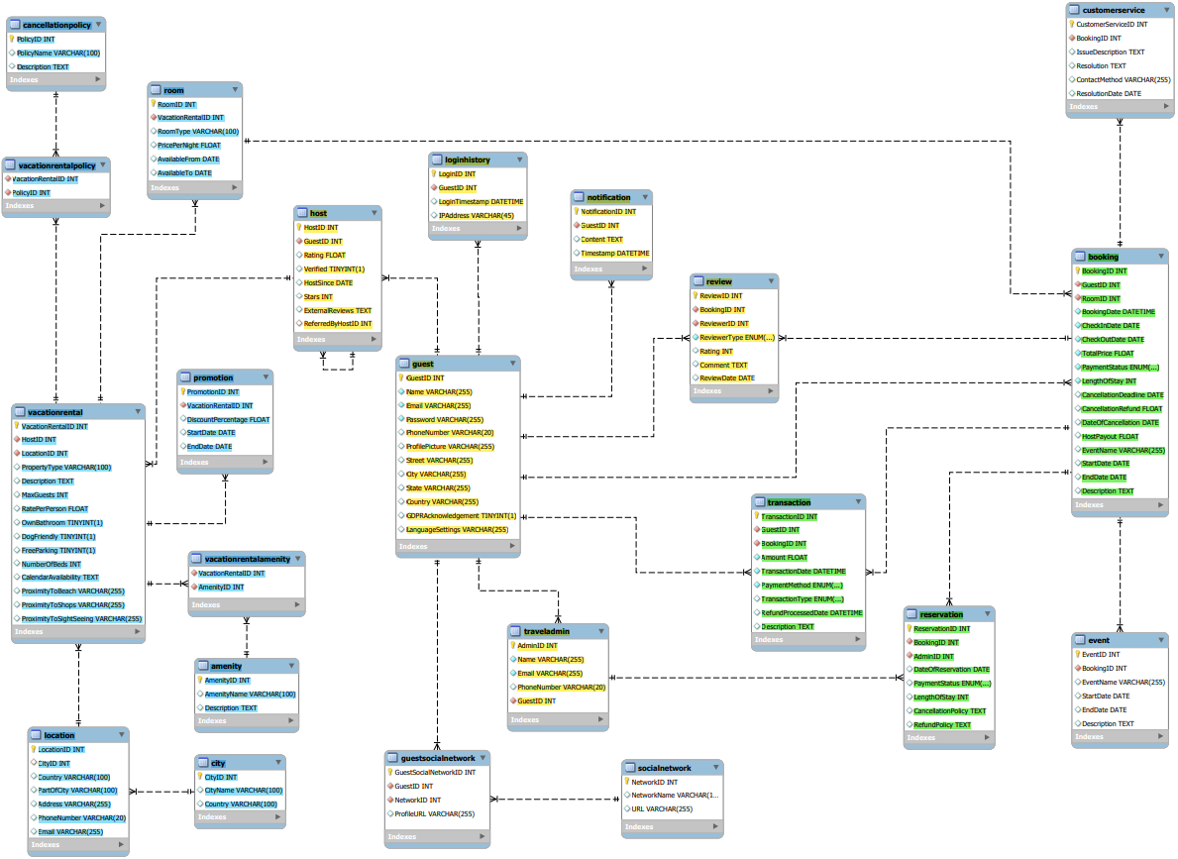
Entity Relationship Model (ERM)

Slide 6
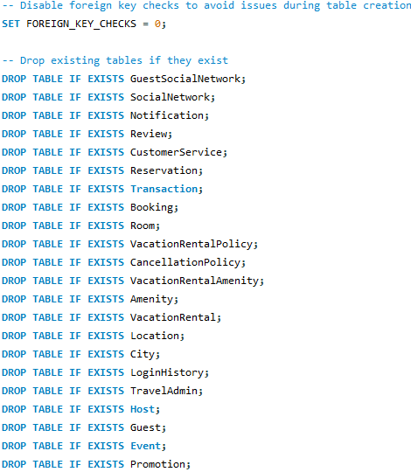
Database Setup
Initialization & Table Preparation:
To begin the implementation, it was necessary to prepare the database environment as shown in the code snippet.
Clean Environment:
Existing tables were dropped to avoid conflicts, ensuring a fresh start for the schema creation.
Foreign Key Checks:
Temporarily disabled during the drop process and re-enabled afterward to maintain integrity.

Slide 7
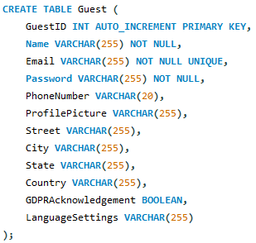
Guest Table
1. Roles:
Guests: Create and manage their own guest profiles.
Hosts: Can view guest information for their bookings.
System Administrators: Ensure data privacy and system-wide guest management.
2. Actions:
Guests: Register, update, and manage their profiles.
Hosts: View guest profiles related to their bookings.
System Administrators: Maintain guest data privacy & manage guest information updates.
3. Data (summarized):
GuestID: Unique identifier for each guest.
Personal Information: Includes name, email (unique), phone number, and password.
Address Information: Street, city, state, country.
Additional Info: Profile picture, GDPR acknowledgement, language settings.
4. Relationships:
Guest - Booking: A guest can have multiple bookings (one-to-many relationship with bookings).
Guest - GuestSocialNetwork: A guest can be linked to multiple social network profiles through the GuestSocialNetwork table.

Slide 8
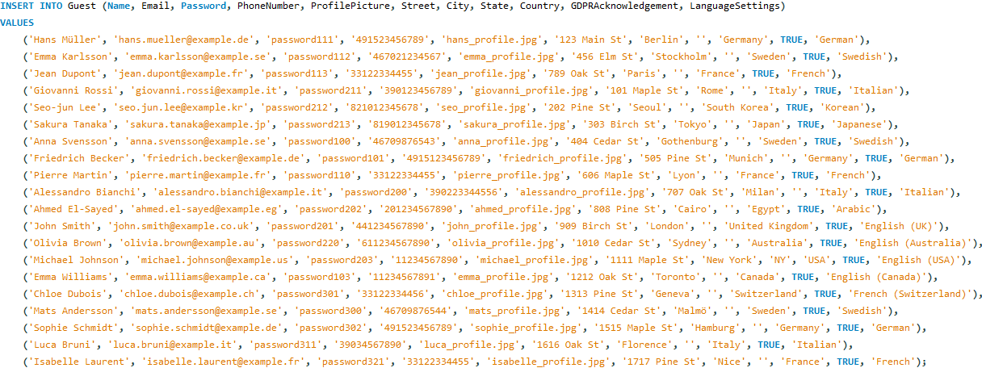
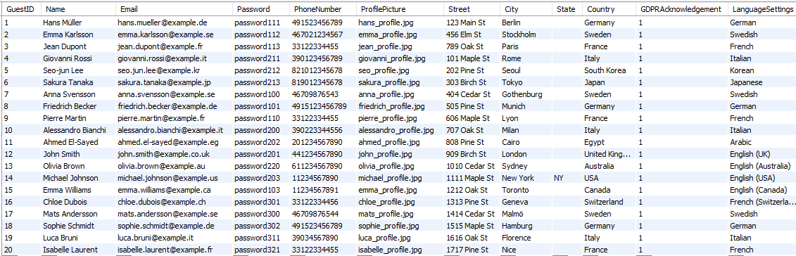
Guest Table

Slide 9
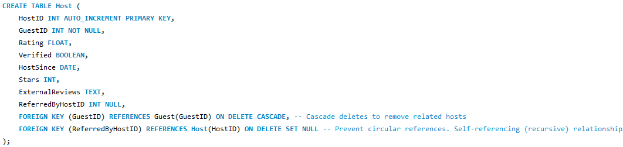
Host Table
1. Roles:
Hosts: Manage their profiles, guest interactions and ratings.
Guests: View host details when booking & reviews.
System Administrators: Verify hosts and manage reviews and ensuring referrals between hosts.
2. Actions:
Hosts: Update profiles, ratings, and refer other hosts.
Guests: View host profiles and ratings.
System Administrators: Verify hosts and maintain referral relationships.
3. Data (summarized):
HostID: PK, uniquely identifying each host.
GuestID: Links hosts to a guest profile (host = guest).
Rating/Stars: Host’s review score & ratings from guests
Verified: Host´s verification status.
HostSince: Date when hosting started.
ReferredByHostID: Tracks host referrals.
4. Relationships:
Host - Guest: Each host is also a guest, creating a one-to-one relationship between the two tables.
Host - Host: Hosts can refer other hosts, establishing a self-referencing (recursive) relationship. This relationship is managed carefully to avoid circular references by using SET NULL if the referring host is deleted.

Slide 10
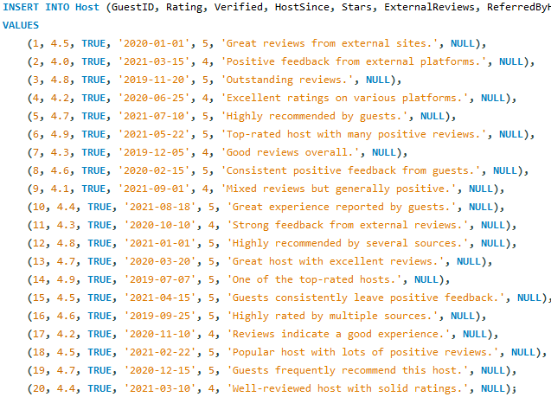
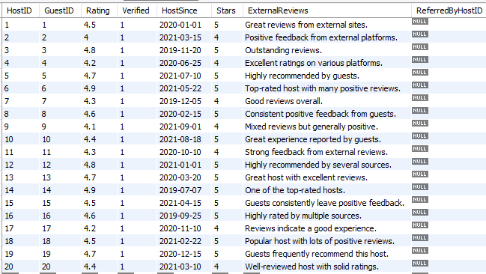
Host Table

Slide 11
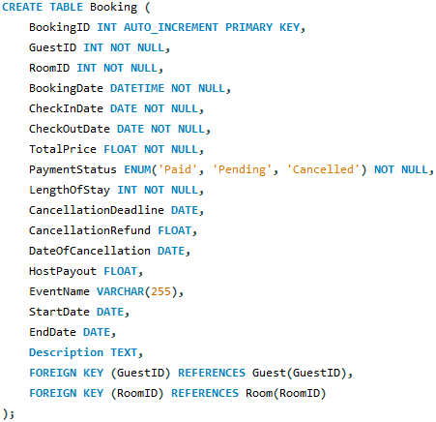
Booking Table
1. Roles:
Guests: Make and manage bookings.
Hosts: Monitor bookings and handle cancellations.
System Administrators: Oversee refunds and cancellations.
2. Actions:
Guests: Create, update, cancel bookings.
Hosts: Manage bookings and refunds.
System Administrators: Process refunds and maintain records.
3. Data (summarized):
Guest & Room Info: Links the booking to a guest (GuestID)/room (RoomID).
Booking & Stay Details: booking date, check-in/check-out, stay length.
Payment Status: Shows total price, paid, pending, or canceled status.
Cancellations/Refunds: Handles deadlines and refunds.
Host & Event Info: Details such as host payout, event name, and event dates.
4. Relationships:
Guest - Booking: One guest, multiple bookings.
Room - Booking: One room, many bookings.
Transaction - Booking: Tracks payments and refunds.

Slide 12
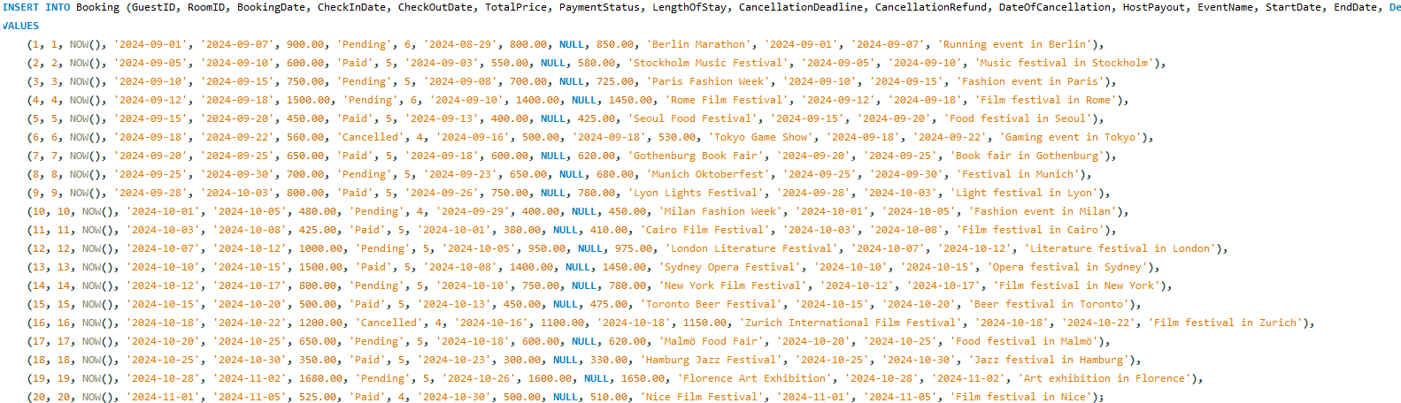
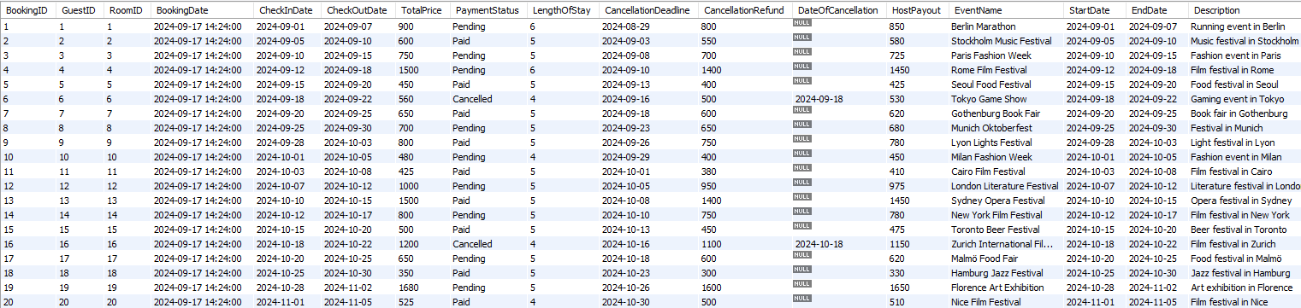
Booking Table

Slide 13
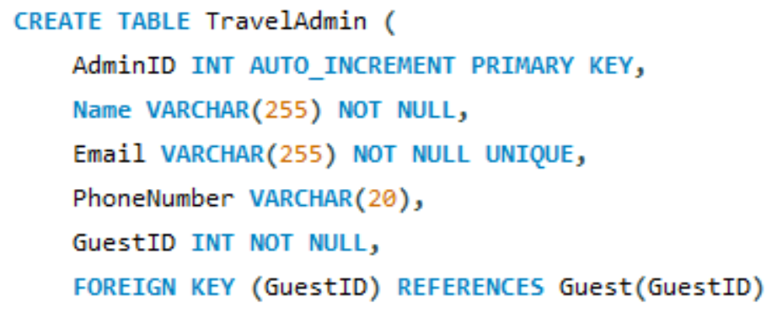
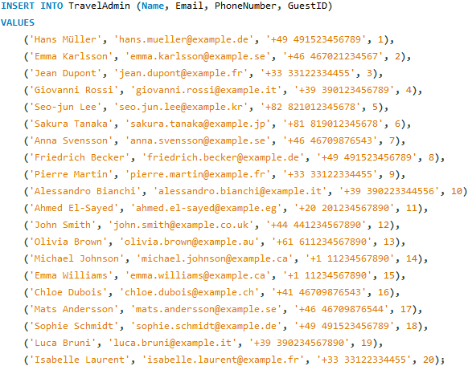
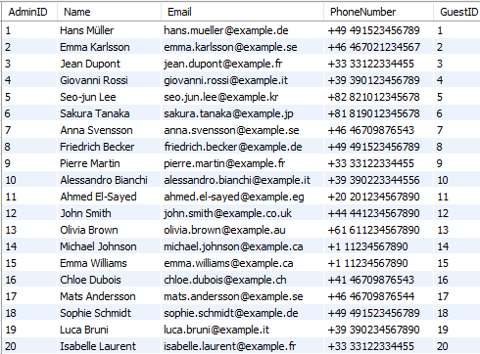
TravelAdmin Table
1. Roles:
Travel Administrators: Oversee guest bookings, cancellations, and other administrative tasks.
System Administrators: Oversee travel admin access and maintain their records.
2. Actions:
Travel Administrators: Manage bookings and policies on behalf of guests.
System Administrators: Set up travel admin accounts and manage access.
3. Data (summarized):
AdminID: Unique identifier for the travel admin.
GuestID: Links each travel admin to a specific guest account for identity purposes.
Contact Information: Includes name, email, and phone number.
4. Relationships:
Guest - TravelAdmin: Each travel admin is associated with a guest account for identity verification.

Slide 14
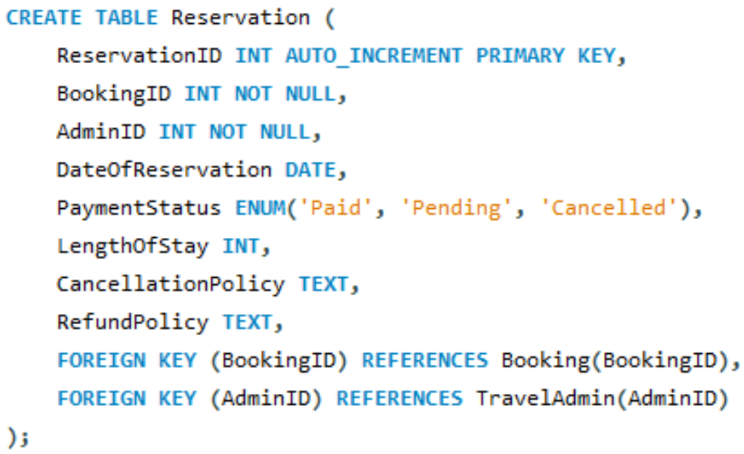
Reservation Table
1. Roles:
Guests: Make reservations and manage payments.
Travel Admins: Monitor and manage reservations and cancellations.
System Administrators: Maintain reservation system integrity and handle platform issues.
2. Actions:
Guests: Create, update, or cancel reservations.
Travel Admins: Process and manage reservations, handle refunds, and apply cancellation policies.
System Administrators: Maintain system for booking, track cancellations and refunds.
3. Data (summarized):
ReservationID: Unique ID for the reservation.
BookingID: Links to a specific booking.
AdminID: References the Travel Admin managing the reservation.
Reservation Details: Date of reservation, payment status, length of stay, cancellation and refund policies.
4. Relationships:
Booking - Reservation: Each reservation is linked to a booking.
Admin - Reservation: Admins are linked to reservations they manage.

Slide 15
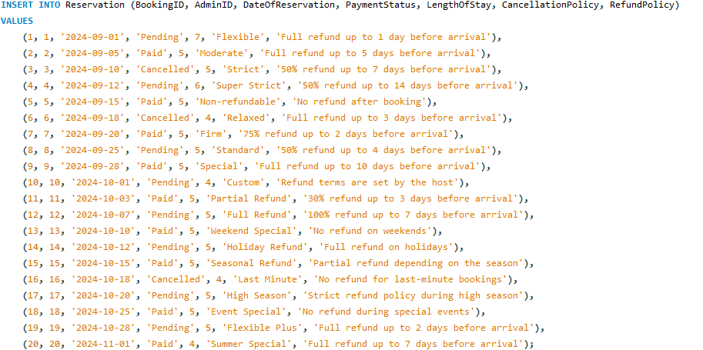
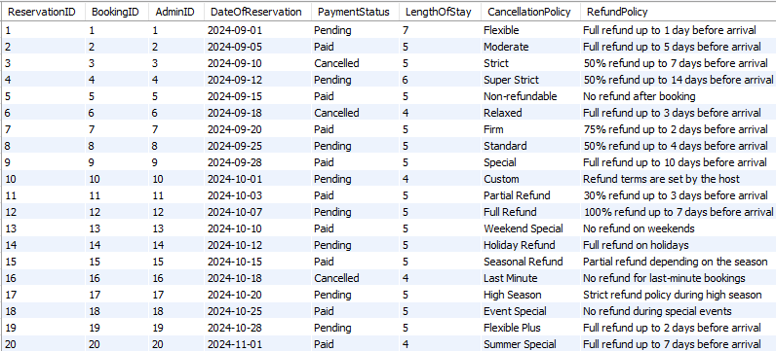
Reservation Table

Slide 16
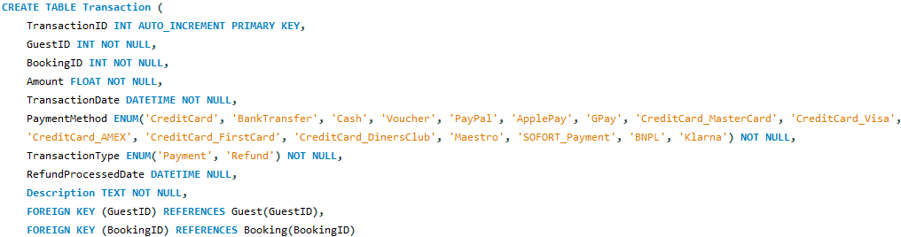
Transaction Table
By managing both payments and refunds in one table, it simplifies the payment process and reduces redundancy, ensuring accurate financial tracking for each booking.
1. Roles:
Guests: Can make payments and receive refunds related to their bookings.
Hosts: Not directly involved but can view payment statuses of guests.
System Administrators: Manage payment processing and ensure refunds are correctly issued.
2. Actions:
Guests: Initiate payments or request refunds.
System Administrators: Process payments, handle refunds, and ensure transaction records are up to date.
3. Data (summarized):
TransactionID: Unique identifier for each transaction.
GuestID & BookingID: Links the transaction to a specific guest and booking.
Amount: The total value of the transaction.
TransactionDate & RefundDate: Tracks when transactions occur, including refund processing dates.
TransactionMethod & Type: Specifies payment method and whether it's a payment or refund.
4. Relationships:
Guest - Transaction: Each guest can have multiple transactions.
Booking - Transaction: Each booking can be associated with multiple transactions.

Slide 17
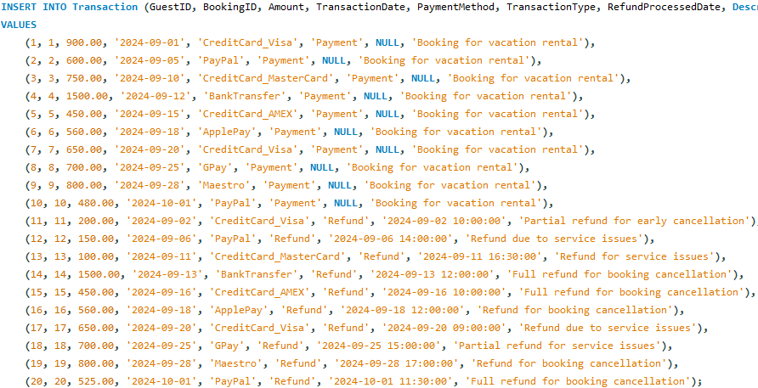
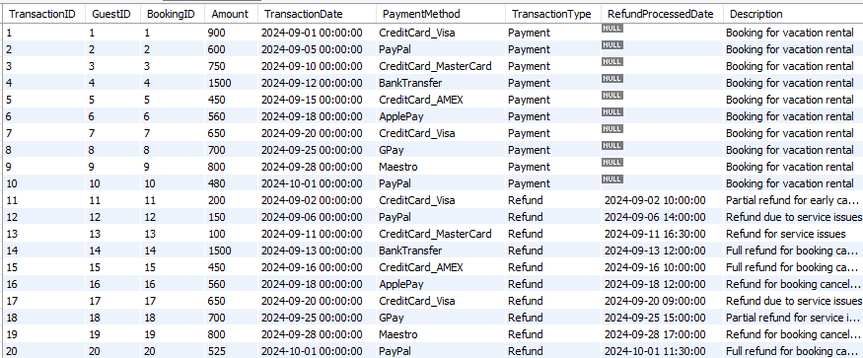
Transaction Table

Slide 18
Review Table
1. Roles:
Guests: Provide reviews for stays.
Hosts: Leave feedback on guests.
System Administrators: Manage review system and ensure quality control.
2. Actions:
Guests: Write reviews for their bookings.
Hosts: Review their guests' behavior and experience.
System Administrators: Ensure review integrity and manage feedbacks.
3. Data (summarized):
ReviewID: Unique ID for each review.
BookingID: Links the review to a specific booking.
ReviewerID: The ID of the reviewer (either guest or host).
Review Details: Type (guest or host), rating, and comment with date.
4. Relationships:
Booking - Review: A booking can have multiple reviews from guests and hosts.
Reviewer - Review: Reviews are linked to the user who left the review, whether guest or host.

Slide 19
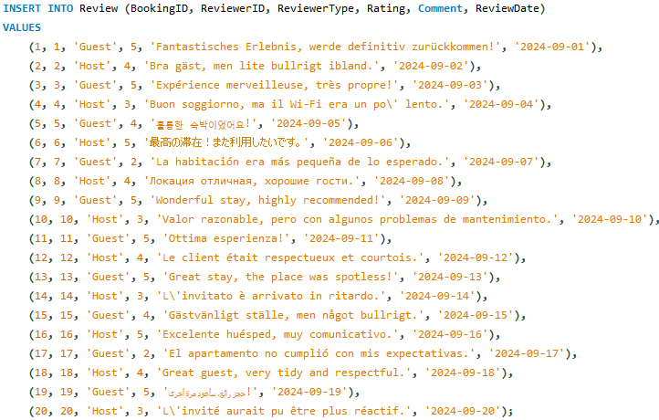
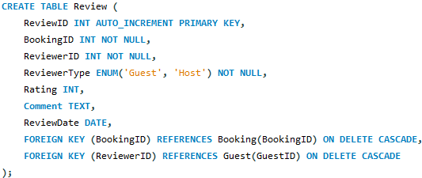
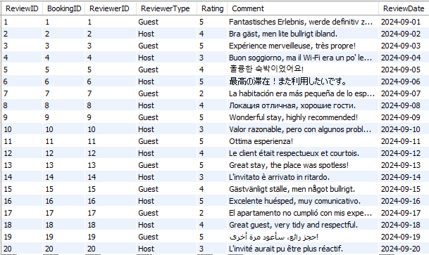
Review Table

Slide 20
CancellationPolicy Table
The CancellationPolicy table defines different cancellation rules (as flexible, strict), while the VacationRentalPolicy table links each vacation rental to specific cancellation policies. This separation allows multiple vacation rentals to share the same cancellation policy, avoiding duplication and ensuring flexibility in assigning policies.
1. Roles:
Guests: Follow cancellation policies before/after booking.
Hosts: Set and manage cancellation policies for their listings.
System Administrators: Manage predefined policies and oversee updates.
2. Actions:
Guests: Review and comply with cancellation terms.
Hosts: Create or update policies for their listings.
System Administrators: Define, update, and remove policy types.
3. Data:
PolicyID: Unique identifier for each cancellation policy, automatically incremented.
PolicyName: The name of the cancellation policy (Flexible, moderate, strict, etc.)
Description: Text description providing details about the policy, such as refund conditions and applicable timelines.
4. Relationships:
VacationRental - CancellationPolicy: Each vacation rental can be associated with a specific cancellation policy (one-to-many).
Booking - CancellationPolicy: Booking is linked to the applicable cancellation policy.

Slide 21
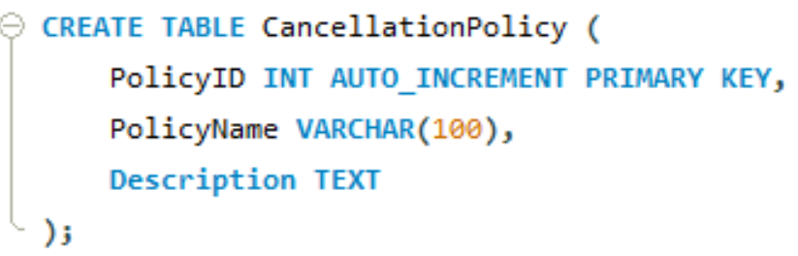
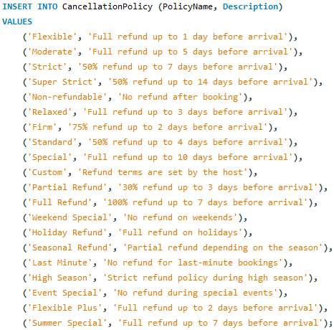
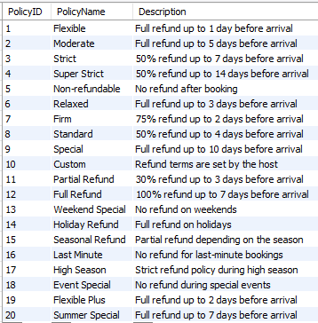
CancellationPolicy Table

Slide 22
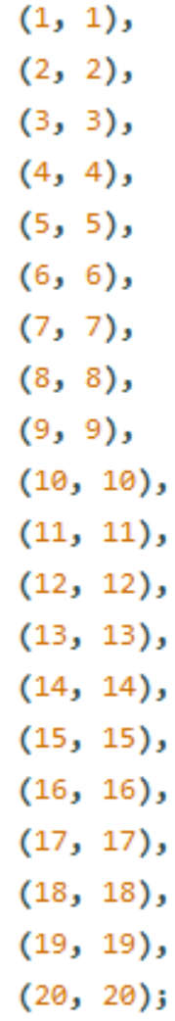
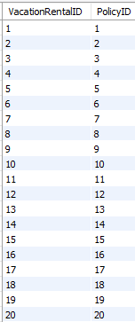
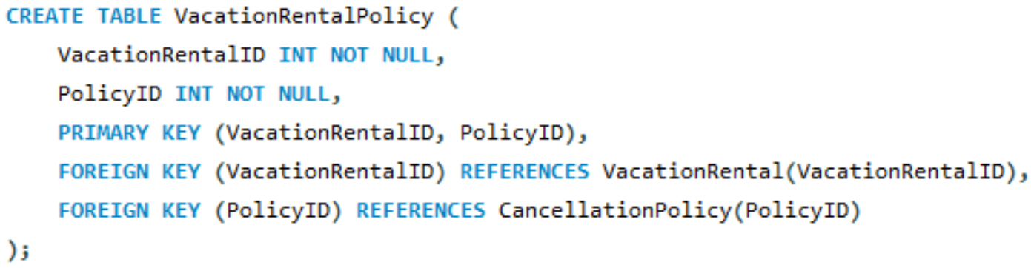
VacationRentalPolicy Table
1. Roles:
Guests: Follow rental-specific policies during their stay.
Hosts: Define property rules and conditions.
System Administrators: Set general policies, ensuring they are followed.
2. Actions:
Guests: Review and agree to rental policies when booking.
Hosts: Create, manage or update policies for their properties.
System Administrators: Define platform policies and assist hosts.
3. Data:
VacationRentalID: The unique identifier for the vacation rental property. It links this policy to a specific vacation rental.
PolicyID: The unique identifier for the policy. It links a vacation rental to a specific policy, such as a cancellation policy.
PRIMARY KEY (VacationRentalID, PolicyID): This composite primary key ensures that each vacation rental is uniquely associated with a specific policy.
4. Relationships:
VacationRental - VacationRentalPolicy: A vacation rental can be linked to multiple policies (one-to-many).
Policy - VacationRentalPolicy: A policy can be applied to multiple vacation rentals (one-to-many).

Slide 23
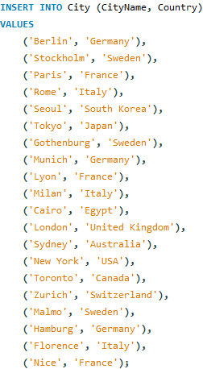
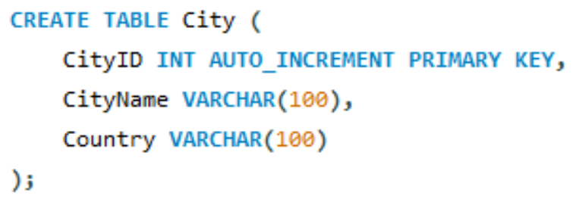
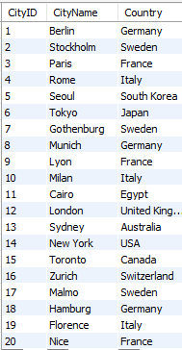
City Table
The City table stores general information about cities, while the Location table links specific vacation rental addresses to a city. This separation allows multiple locations within the same city, providing flexibility and avoiding data duplication.
1. Roles:
Guests: View cities to find available rentals.
Hosts: Ensure city information is correct for their listings.
System Administrators: Manage and update city records.
2. Actions:
Guests: Search for rentals by city.
Hosts: Add or verify city names and countries for their listings.
System Administrators: Ensure unique and accurate city entries.
3. Data:
CityID: Unique identifier for each city.
CityName: Name of the city (Berlin, Paris, etc.).
Country: Location of country.
4. Relationships:
City - Location: Each city can have multiple linked locations (one-to-many).

Slide 24
Location Table
1. Roles:
Guests: Search and view detailed rental
location information.
Hosts: Add or update specific location details
for their properties.
System Administrators: Oversee and ensure correct location entries.
2. Actions:
Guests: Browse locations for vacation rentals.
Hosts: Enter specific location details (address and contact).
System Administrators: Link locations to cities and maintain data accuracy.
3. Data:
LocationID: Unique identifier for each location.
CityID: Foreign key linking the location to a city.
Country: Country where the location is situated.
PartOfCity: Specific district or area within a city (Mitte, Montmartre, etc.).
Address: Full address of the rental property.
PhoneNumber: Contact phone number for the location.
Email: Contact email for inquiries.
4. Relationships:
Location - City: Each location is linked to one city (many-to-one).

Slide 25
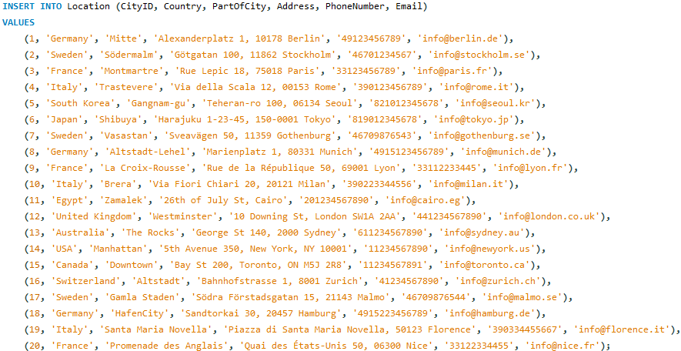
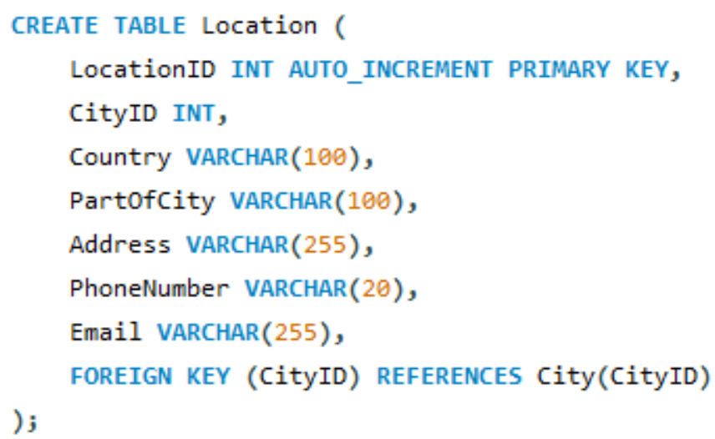
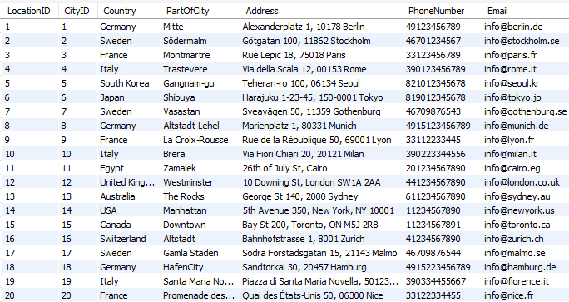
Location Table

Slide 26
CustomerService Table
1. Roles:
Guests: Can request assistance related to their bookings.
Hosts: Request support regarding bookings or property issues.
Customer Service Representatives: Provides support and resolve issues for both guests and hosts.
System Administrators: Manage customer service requests and feedback.
2. Actions:
Guests & Hosts: Submit service requests related to bookings.
Customer Service Representatives: Escalate and resolve issues.
System Administrators: Track service requests, improve service quality, and find solutions.
3. Data:
CustomerServiceID: Unique identifier for each service request.
BookingID: Links the request to the specific booking.
IssueDescription: Detailed description of the problem or concern.
Resolution: Type of resolution offered for the issue.
ContactMethod: How the customer was contacted (phone, email.)
ResolutionDate: Records the date the request was submitted.
4. Relationships:
CustomerService - Booking: Each customer service entry is linked to a specific booking (BookingID).
Booking - CustomerService: One booking can be associated with multiple customer service issues.

Slide 27
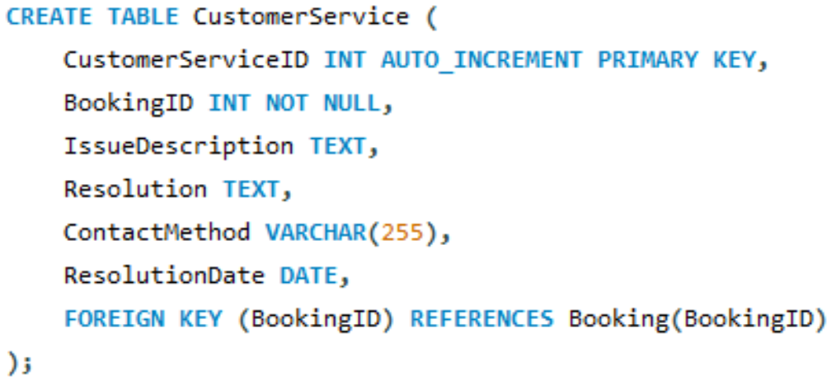
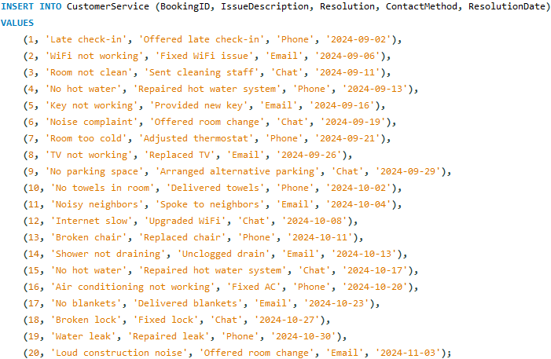
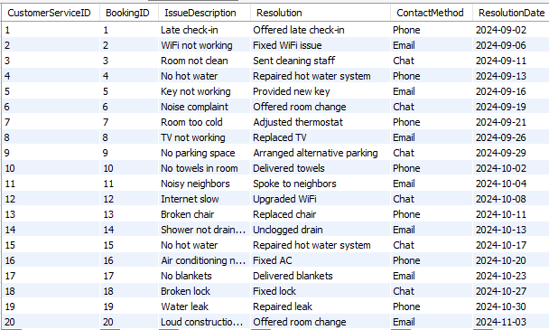
CustomerService Table

Slide 28
SocialNetwork Table
The SocialNetwork table stores information about social media platforms, including the name and URL of each network (e.g., Facebook, Twitter).
The GuestSocialNetwork table links guests to their social media profiles by referencing both the Guest and SocialNetwork tables. It allows guests to associate specific social media profiles (e.g., profile URL) with the social networks they use.
1. Roles:
Guests and Hosts: Use their social network accounts to link profiles or authenticate on the platform.
System Administrators: Manage the supported social networks available for account linking or sharing purposes.
2. Actions:
Guests and Hosts: Link their social media accounts to the platform, such as Facebook, Twitter, or Instagram.
System Administrators: Add new social network platforms and manage their integration.
3. Data:
NetworkID: Unique identifier for each social network.
NetworkName: The name of the social network (Facebook, Instagram, etc.).
URL: The base URL for the social network (www.facebook.com, etc.).
4. Relationships:
GuestSocialNetwork - SocialNetwork: Guests and hosts can link their social media accounts, which are referenced from the social network table (many-to-one relationship).

Slide 29
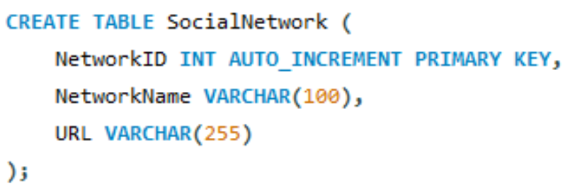
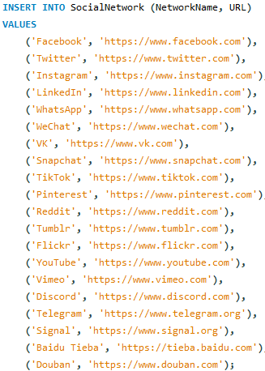
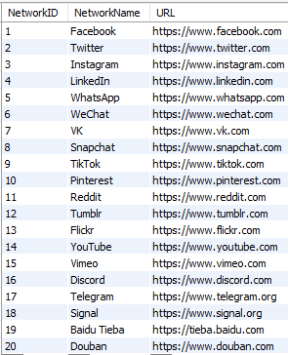
SocialNetwork Table

Slide 30
GuestSocialNetwork Table
1. Roles:
Guests: Link their social network profiles to their accounts.
System Administrators: Ensure that guest profiles are properly linked to their social media accounts.
2. Actions:
Guests: Add or update social network profile information.
System Administrators: Maintain social network connections.
3. Data:
GuestSocialNetworkID: Unique identifier for each guest's social network post.
GuestID: Links the social network profile to the guest's account.
NetworkID: Identifies the social network (Facebook, Twitter, etc.).
ProfileURL: The URL to the guest’s profile on the social network.
4. Relationships:
Guest - GuestSocialNetwork: A guest can have multiple social network profiles linked to their account.
SocialNetwork - GuestSocialNetwork: A social network (Facebook, etc.) can be associated with multiple guests.

Slide 31
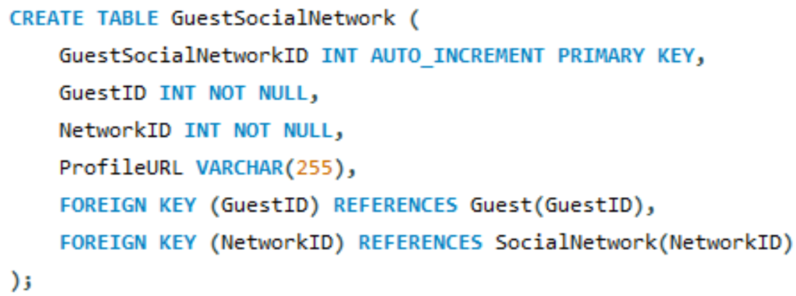
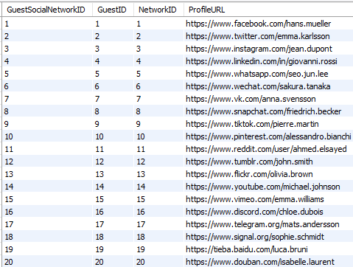
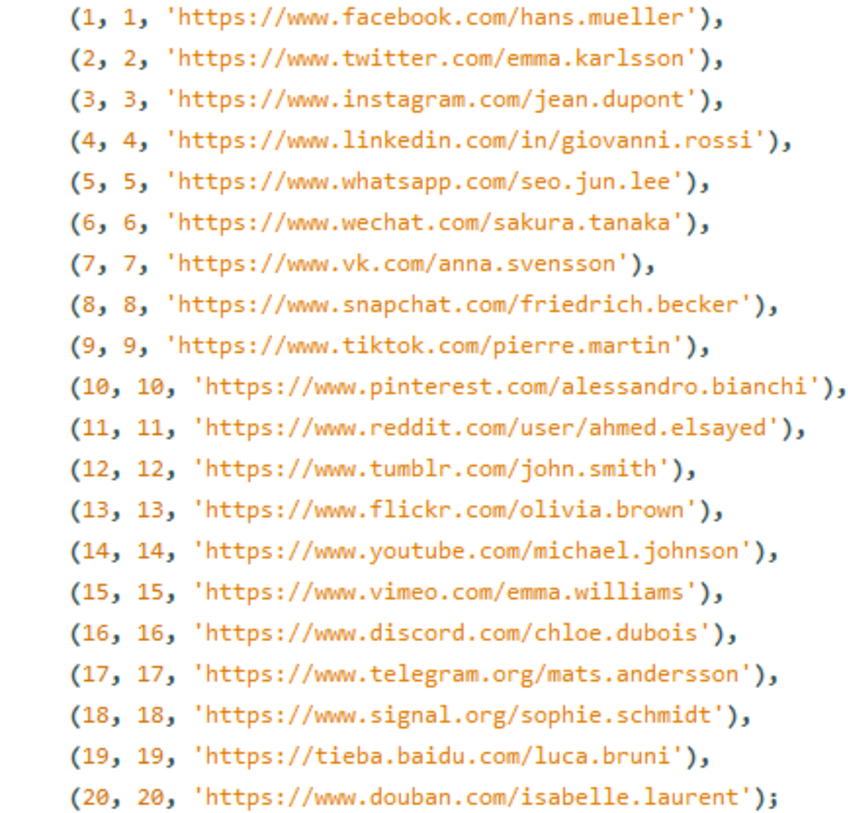
GuestSocialNetwork Table

Slide 32
Amenity Table
The VacationRentalAmenity Table is a junction (associative) table that connects the VacationRental table and the Amenity table.
It handles the many-to-many relationship between vacation rentals and amenities.
Each row in this table represents one amenity being available at one specific vacation rental.
1. Roles:
Guests: View available amenities at vacation rentals.
Hosts: Define and list amenities provided in their properties.
System Administrators: Oversee amenity listings across the platform.
2. Actions:
Guests: Check amenities while booking a property.
Hosts: Add, update, or remove amenities for their properties.
3. Data:
AmenityID: Unique identifier for each amenity (Primary Key).
AmenityName: Wi-Fi, Pool, Parking, etc.
Description: Details or extra information about the amenity.
4. Relationships:
No Direct Relationships: The Amenity table does not contain any foreign keys and therefore does not have direct relationships with other tables.
Lookup Table: It serves as a reference table, where each amenity (Wi-Fi, Pool, etc.) can be referenced elsewhere in the system, such as in a junction table that links properties to amenities.

Slide 33
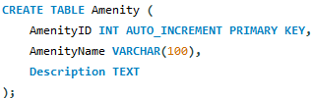
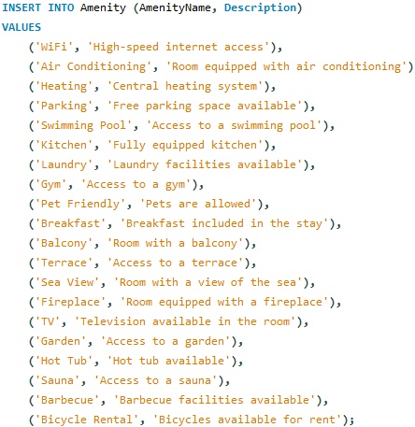
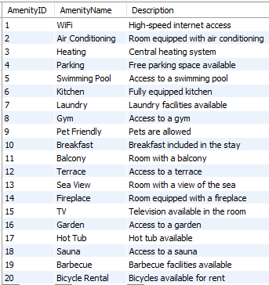
Amenity Table

Slide 34



VacationRentalAmenity Table
1. Roles:
Guests: View available amenities when booking a vacation rental.
Hosts: Define and manage the amenities offered at their vacation rentals.
System Administrators: Oversee and ensure the proper linking of amenities to vacation rentals.
2. Actions:
Guests: View amenities during the booking process.
Hosts: Assign or update amenities for each rental property.
System Administrators: Maintain the database structure, ensure accurate linking of rentals and amenities.
3. Data:
VacationRentalID: Unique identifier linking a vacation rental to specific amenities.
AmenityID: Unique identifier for each amenity (Wi-Fi, Pool, etc.).
4. Relationships:
VacationRental - VacationRentalAmenity: Each vacation rental can have multiple amenities.
Amenity - VacationRentalAmenity: Each amenity can be linked to multiple vacation rentals (many-to-many relationship).

Slide 35
Room Table
The Room table represents individual units or spaces within a vacation rental, such as a suite or deluxe room, with specific details like room type and nightly price.
The VacationRental table on the other hand refers to the entire property available for rent, like a house or apartment, and includes general property details such as location, maximum guests, and amenities available for the whole rental.
1. Roles:
Guests: View room availability and pricing when searching for vacation rentals.
Hosts: Define room types, pricing, and availability for their vacation rental properties.
System Administrators: Ensure data integrity and maintain the association between vacation rentals and rooms.
2. Actions:
Guests: Search for available rooms, price and dates.
Hosts: Add, update, or remove room details including availability, pricing, and room type.
System Administrators: Oversee room data, ensuring it is accurate and linked to the correct vacation rentals.
3. Data:
RoomID: Unique identifier for each room.
VacationRentalID: Links the room to a specific vacation rental.
RoomType: Specifies the type of room (e.g., single, double, suite).
PricePerNight: The nightly rate for the room.
AvailableFrom & AvailableTo: Specifies the availability date range of the room.
4. Relationships:
VacationRental-Room: Each room is associated with a specific vacation rental, and a vacation rental can have multiple rooms.

Slide 36



Room Table

Slide 37
VacationRental Table
1. Roles:
Guests: Browse and book vacation rentals.
Hosts: Manage the details of their vacation rentals.
System Administrators: Oversee and maintain the accuracy of vacation rental data.
2. Actions:
Guests: Search and view rental details, book rentals based on availability.
Hosts: Create, update, or remove their vacation rentals.
System Administrators: Ensure rental data is up to date, monitor system-wide records.
3. Data:
VacationRentalID: Unique identifier for each rental property.
HostID: Links the rental to the host.
LocationID: Links the rental to a specific location.
PropertyType: The type of rental (loft, villa, etc.).
MaxGuests: Allowed maximum number of guests.
RatePerPerson: Price charged per person.
CalendarAvailability: Availability of the rental property.
Proximity Details: Distance to beach, shops, sightseeing.
Other Features: Own bathroom, dog-friendly, free parking, number of beds.
4. Relationships:
Host -VacationRental: Each vacation rental is linked to a host (via HostID).
Location - VacationRental: Each rental is connected to a specific location (via LocationID).

Slide 38



VacationRental Table

Slide 39



Notification Table
1. Roles:
Guests: Receive and view notifications.
System Administrators: Manage notifications sent to guests.
2. Actions:
Guests: View and respond to notifications.
System Administrators: Create and send notifications to guests.
3. Data:
NotificationID: Unique identifier for each notification.
GuestID: Links the notification to a specific guest.
Content: The message or content of the notification.
Timestamp: The date and time when the notification was created.
4. Relationships:
Guest - Notification: Each notification is linked to one guest, but a guest can have multiple notifications.

Slide 40
Promotion Table
The Promotion table is linked to VacationRental and manages discounts and special offers which affects the price guests pay indirectly. It influences the rental price without being directly tied to the payments table.
1. Roles:
Guests: View promotions for properties they are interested in.
Hosts: Create and manage promotions for their vacation rentals.
System Administrators: Oversee and maintain promotional campaigns.
2. Actions:
Guests: View and apply promotions when booking rentals.
Hosts: Create and update promotions for their properties.
System Administrators: Ensure proper application and visibility of promotions.
3. Data:
PromotionID: Unique identifier for each promotion.
VacationRentalID: Links the promotion to a specific vacation rental.
DiscountPercentage: The discount amount offered through the promotion.
StartDate & EndDate: The period during which the promotion is active.
4. Relationships:
VacationRental - Promotion: Each promotion is tied to one vacation rental, but a rental can have multiple promotions at different times.

Slide 41



Promotion Table

Slide 42



LoginHistory Table
1. Roles:
Guests/Hosts: Their login activity is tracked for security and monitoring purposes.
System Administrators: Monitor user activity and maintain security measures.
2. Actions:
Guests/Hosts: Log in to the system.
System Administrators: Track and review login activity, ensure system security.
3. Data:
LoginHistoryID: Unique identifier for each login session.
UserID: Refers to the guest or host who logged in.
LoginTime: Timestamp indicating when the user logged in.
LogoutTime: Timestamp indicating when the user logged out.
IPAddress: The IP address used during login.
4. Relationships:
User - LoginHistory: Each user can have multiple login entries recorded.

Slide 43



Event Table
1. Roles:
Guests: Attend or view information about events linked to their bookings.
Hosts: Can view any events related to their rental bookings.
System Administrators: Link events to relevant bookings or update event details.
2. Actions:
Guests & Hosts: View event details linked to their bookings.
System Administrators: Ensure event and booking relationships are maintained.
3. Data:
EventID: Unique identifier for each event.
BookingID: Links the event to a specific booking.
EventName: The name or title of the event.
StartDate & EndDate: Of an event.
Description: Additional details about the event.
4. Relationships:
Booking-Event: One booking can have multiple events associated with it (one-to-many relationship).

Slide 44






Test Cases
Test cases are queries that verify if the data and design are correct, using joins to extract data from three or more tables.
This query joins 5 tables: Booking, Guest, Room, VacationRental, and Host, retrieving guest name, booking details, property type, and host rating using inner joins on related foreign keys.
________________________________________________________________________________
This query joins 3 tables: Transaction, Booking, and Guest. It retrieves guest payment and booking details, with transaction information, including both payments and refunds, based on the TransactionType field. The results are ordered by the transaction date to display the most recent transactions first.
________________________________________________________________________________
This query joins 6 tables: Guest, Booking, Review, CustomerService, Room, VacationRental, and Host, retrieving guest name, property type, review rating and comment, customer service details, and host information using both inner and left joins on related foreign keys.
43

Slide 45


Data Population & Testing
Data Population:
Each table was populated with at least 20 entries to ensure that the database could be effectively tested and validated.
Validation and Testing:
Test cases were conducted to verify the integrity of the design, ensuring that the database accurately reflected the ER model and performed as expected.
DLBDSPBDM01 - Anita Skynar - 92124577
44

Slide 46


Integrity Check
Procedure:
A SQL query was performed to identify ´Booking´ records without valid ´Guest´ references using a ´Left Join´.
Ensuring that all bookings are correctly linked to guests prevents orphaned records, which could lead to inconsistent data and errors in reports or queries.
This check helps maintain data reliability across the platform.
Outcome:
The empty result grid confirms all bookings are correctly linked to guests, ensuring data integrity.
45
DLBDSPBDM01 - Anita Skynar - 92124577

